Slide 1
MIT9313 alternative ORFs from proteome ISME16

Slide 2
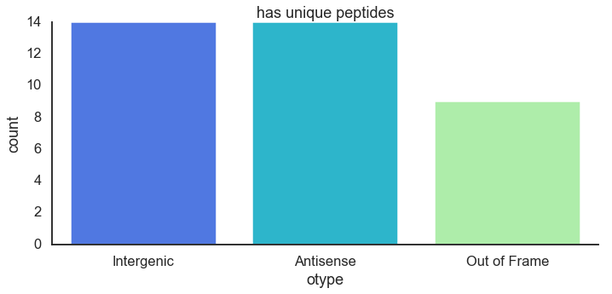
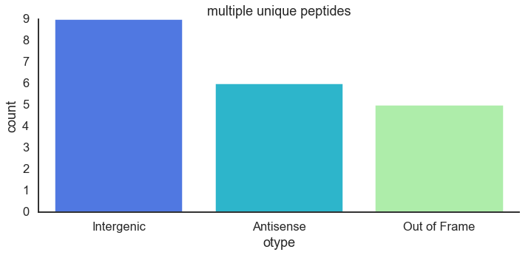
All ORFS in all lengths

Slide 3
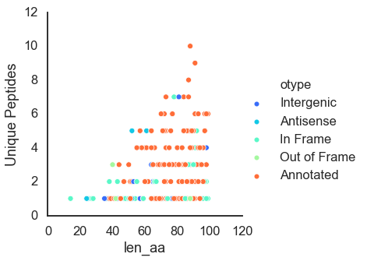
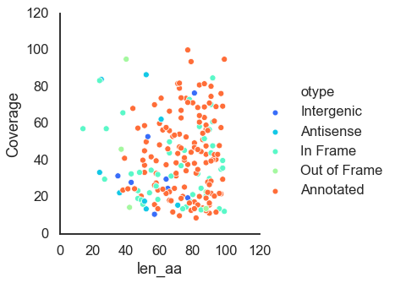
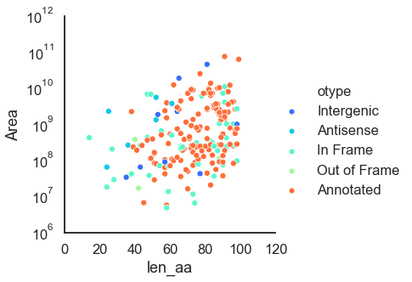
Number of unique peptides
coverage
area
Short proteins (upto 100 aa)

Slide 4
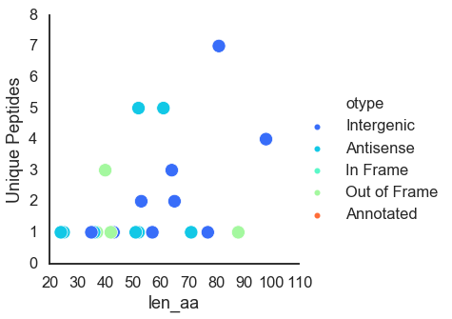
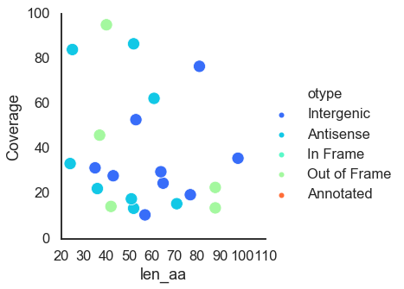
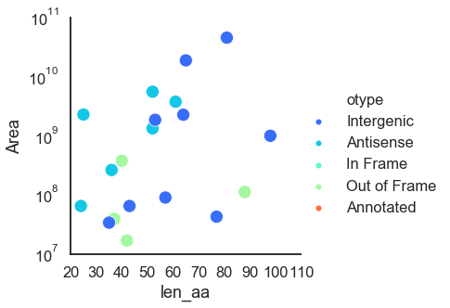
Number of unique peptides
coverage
area
Without annotated genes

Slide 5
CCRG and ProcM/A proteins in NCBI MIT9313 annotation
family | function | in ncbi | From ref
ABC transporter | ATP-binding cassette domain-containing protein | 1 | 1
CCRG-1 | guanylate-binding protein | 1 | 1
 | hypothetical protein | 2 | 0
CCRG-2 | CCRG-2 family RiPP | 12 | 3
 | CCRG-2 family protein | 3 | 3
 | hypothetical protein | 3 | 0
ProcA | Nif11-like leader peptide family natural product precursor | 34 | 14
 | lantipeptide | 1 | 0
procM | lantipeptide-modifying enzyme LanM | 1 | 1
Family | in ref
ABC transporter | 1
CCRG-1 | 3
CCRG-2 | 12
ProcA | 29
procM | 1

Slide 6
CCRG and ProcM/A proteins in NCBI MIT9313 annotation
Before mapping based on left/right coords
In current annotation
family | product | Current ncbi | From paper
CCRG-1 | guanylate-binding protein | 1 | 1
CCRG-2 | CCRG-2 family RiPP | 12 | 3
 | CCRG-2 family protein | 3 | 3
ProcA | Nif11-like leader peptide family natural product precursor | 34 | 14
procM | lantipeptide-modifying enzyme LanM | 1 | 1
Family | Count in original paper
CCRG-1 | 3
CCRG-2 | 12
ProcA | 29
procM | 1

Slide 7
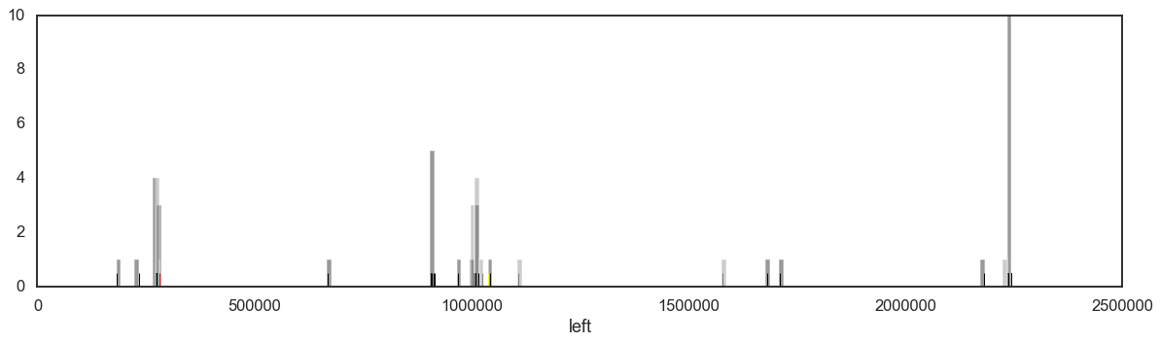
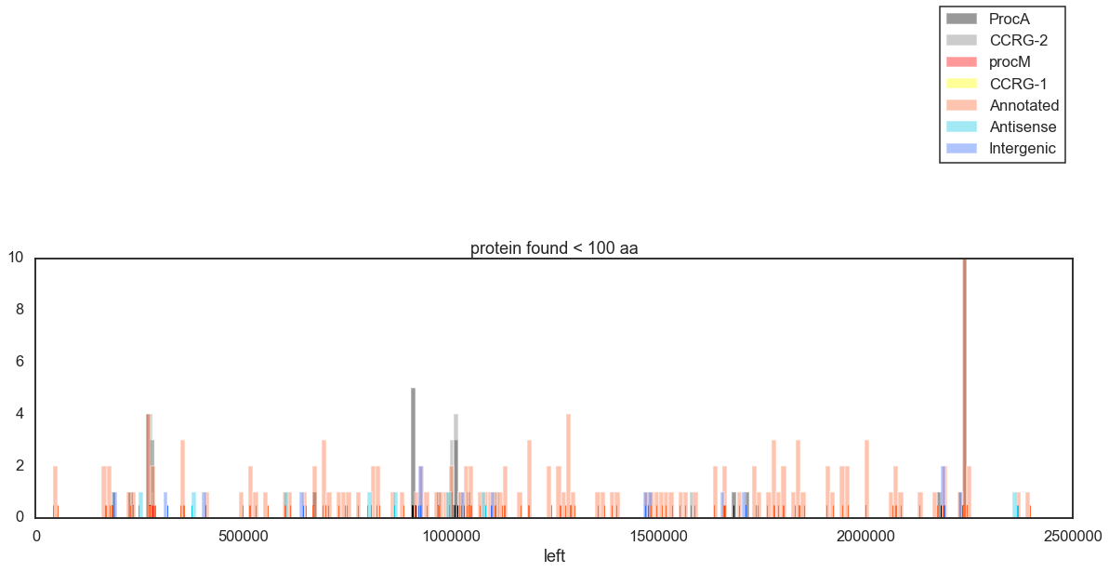

Slide 8
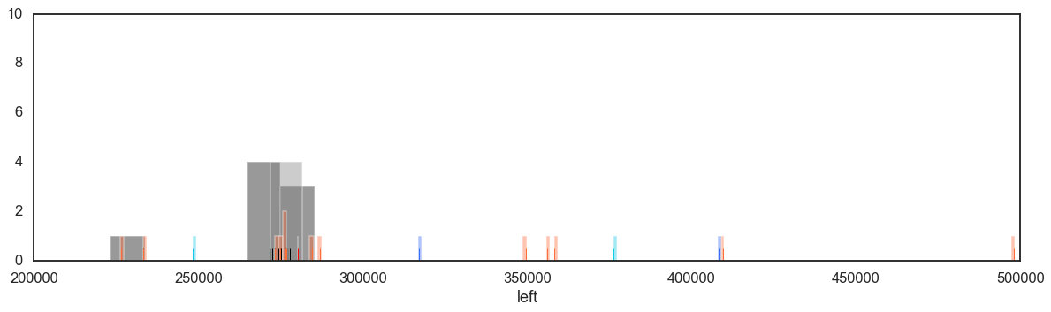
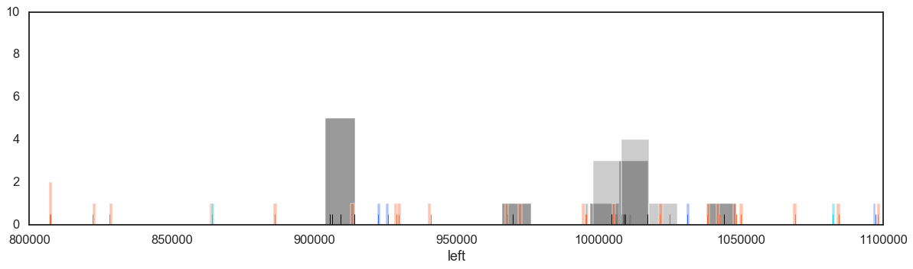
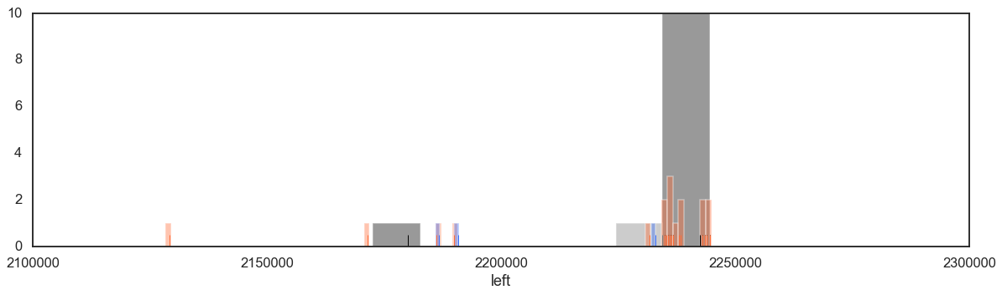
Zoom in

Slide 9
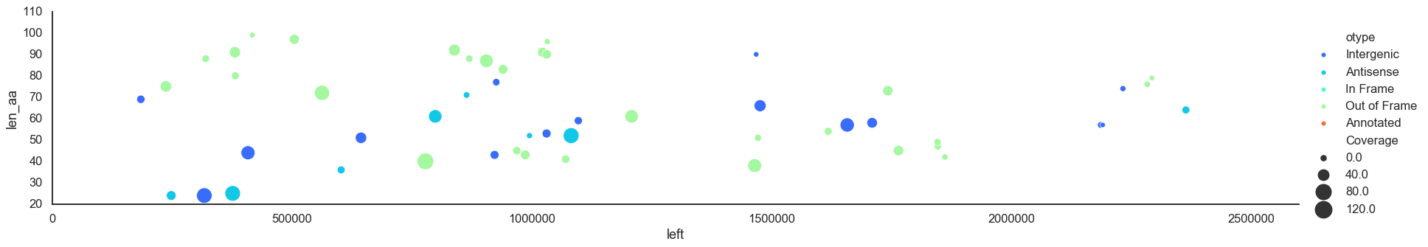
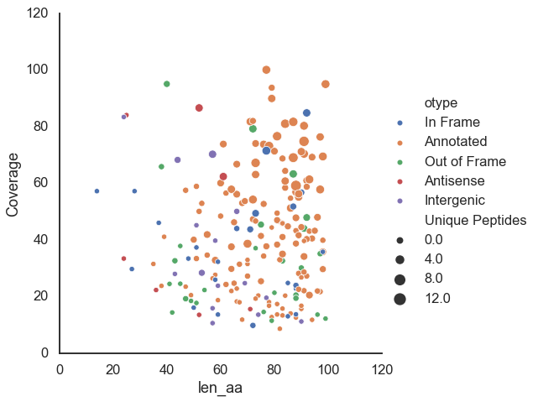

Slide 10
Breakdown of SORFS found in MS
type | family
Annotated | CCRG-1 | 1
 | CCRG-2 | 2
 | ProcA | 16
in frame | ProcA | 3
out of flame | ProcA | 1
type | Annotated | Antisense | In Frame | Intergenic | Out of Frame
CCRG-1 | 1
CCRG-2 | 2
DUF | 15 |  | 2 |  | 3
HLIP | 5 |  |  |  | 2
N/A |  |  |  | 30
ProcA | 16 |  | 3 |  | 1
hypothetical | 60 | 4 | 3 |  | 11
other | 26 | 4 | 2 |  | 9
photosystem | 7 |  | 1 |  | 1
ribosomal | 11 |  |  |  | 2
Annotated | 143
Intergenic | 30
Out of Frame | 29
In Frame | 24
Antisense | 8

Slide 11
No cluster
Clustering according to BLAST
Annotated 108
Intergenic 28
Out of Frame 23
In Frame 8
Antisense 8
cluster_id family2 product
1 ProcA Nif11-like leader peptide family natural product precursor 18
lantipeptide 1
2 N/A 2
hypothetical hypothetical protein 1
3 HLIP high light inducible protein 7
other ssl1498 family light-harvesting-like protein 1
4 hypothetical hypothetical protein 2
5 hypothetical hypothetical protein 2
6 hypothetical hypothetical protein 2
7 hypothetical hypothetical protein 2
8 hypothetical hypothetical protein 1
other RNA recognition motif-containing protein 1
9 CCRG-2 CCRG-2 family RiPP 1
hypothetical protein 1
other bacteriocin 2
10 other carboxysome peptide A 1
carboxysome peptide B 1

Slide 12
Family product
CCRG-1 guanylate-binding protein 1
CCRG-2 CCRG-2 family RiPP 1
hypothetical protein 1
DUF DUF4278 domain-containing protein 2
DUF1816 domain-containing protein 1
DUF1995 family protein 1
DUF2470 domain-containing protein 1
DUF2555 domain-containing protein 1
DUF2839 domain-containing protein 1
DUF2862 domain-containing protein 1
DUF2949 domain-containing protein 1
DUF2973 domain-containing protein 1
DUF2996 domain-containing protein 1
DUF3136 domain-containing protein 1
DUF3148 domain-containing protein 1
DUF3181 family protein 1
DUF3188 domain-containing protein 1
DUF3252 domain-containing protein 1
DUF3303 family protein 1
DUF3721 domain-containing protein 1
DUF3764 family protein 1
DUF751 family protein 1
HLIP high light inducible protein 7
N/A 30
ProcA Nif11-like leader peptide family natural product precursor 19
lantipeptide 1
hypothetical hypothetical protein 78

Slide 13
photosystem photosystem I core protein PsaB 1
photosystem I iron-sulfur center protein PsaC 1
photosystem I reaction center subunit IV 1
photosystem I reaction center subunit PsaK 1
photosystem II protein Y 1
photosystem II reaction center protein J 1
photosystem II reaction center protein L 1
photosystem II reaction center protein PsbH 1
photosystem II reaction center protein PsbN 1
ribosomal 30S ribosomal protein S13 1
30S ribosomal protein S15 1
30S ribosomal protein S17 1
30S ribosomal protein S18 1
30S ribosomal protein S19 1
30S ribosomal protein S21 1
50S ribosomal protein L27 1
50S ribosomal protein L28 1
50S ribosomal protein L29 1
50S ribosomal protein L31 1
50S ribosomal protein L32 1
50S ribosomal protein L33 1
50S ribosomal protein L36 1

Slide 14
bacteriocin 2
2Fe-2S iron-sulfur cluster binding domain-containing protein 2
NifU family protein 1
YlxR family protein 1
ssl1498 family light-harvesting-like protein 1
cytochrome b559 subunit alpha 1
pterin-4-alpha-carbinolamine dehydratase 1
ion transporter 1
carboxysome peptide B 1
translation initiation factor IF-1 1
response regulator transcription factor 1
PipX family protein 1
BolA family transcriptional regulator 1
MEKHLA domain-containing protein 1
chemotaxis protein 1
YciI family protein 1
glutaredoxin 3 1
SDR family NAD(P)-dependent oxidoreductase 1
NAD(P)H-quinone oxidoreductase subunit O 1
transcriptional repressor 1
Pr2TM family membrane protein 1
CopG family transcriptional regulator 1
ATP-dependent Clp protease adapter ClpS 1
RNA methyltransferase 1
DNA mismatch repair protein MutS 1
pentapeptide repeat-containing protein 1
16S rRNA (cytidine(1402)-2'-O)-methyltransferase 1
RNA recognition motif-containing protein 1
sulfur carrier protein ThiS 1
rubredoxin 1
4a-hydroxytetrahydrobiopterin dehydratase 1
flagellar basal body rod protein 1
HU family DNA-binding protein 1
NAD(P)-dependent oxidoreductase 1
FADH(2)-oxidizing methylenetetrahydrofolate--tRNA-(uracil(54)-C(5))- methyltransferase TrmFO 1
carboxysome peptide A 1
chlororespiratory reduction protein 7 1
Asp-tRNA(Asn)/Glu-tRNA(Gln) amidotransferase subunit GatC 1
cupin domain-containing protein 1

